Slide 1
^{7th} Meeting of the S-100 Working Group
S-100 Validation Tests Workshop
Liz HAHESSY & Jonathan PRITCHARD
Agenda Item 8

Slide 2
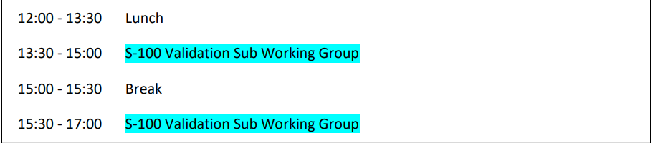
Objectives
Formation of Sub Working Group
Lead: Liz Hahessy
Volunteers – if want to participate email Yong Baek (yong.baek@iho.int) and Liz Hahessy (elihh@gst.dk)
Agree next meeting
Consensus on different types of Validation
Explanation of background, existing work and discussion around potential issues. Develop understanding of the task and importance
Agree on next steps and actions
If time:
Agree format structure for S-100 Validation Tests
look at some of the existing proposed S-100 Validation tests

Slide 3
What is required?
Validation tests between multiple product specifications, aimed at increasing the harmonisation of datasets and user experience of them for live navigation on the S-100 ECDIS.
Need to ensure safe navigation whilst using multiple interoperable product specifications
Safe = ECDIS Behaviour e.g. if alarms on S-102 must alarm on S-101
Need to ensure data producers understand the implications of producing multiple product specifications
Enable validation software to be produced that supports S-100 validation

Slide 4
What is required?
HSSC task – HSSC14/15
Action:
“For the same reasons as above, HSSC noted the slow progress on the development of a harmonized data validation process and associated catalogues across the S100 framework and agreed on the establishment of a dedicated subgroup.”
Deadline:
HSSC 15

Slide 5
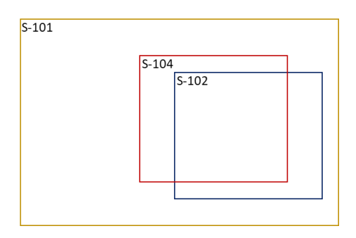
Why is it necessary?
Producing multiple datasets containing similar data that needs to interoperate and be safe for use
Not necessarily same model
Not same limits (no requirements for coincident/identical coverage)
May not be the same data producer
S-57 Band 3
S-57 Band 4
S-57 Band 4

Slide 6
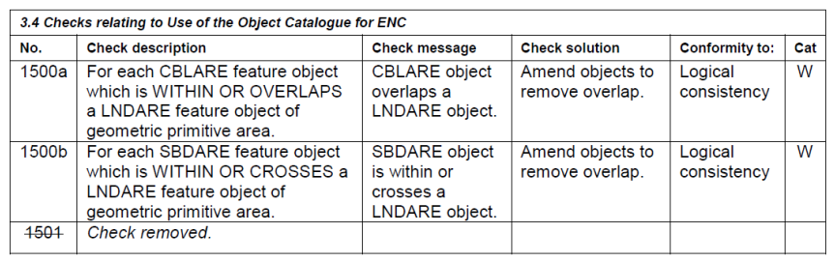
What is validation?
Current validation
Modelled from S-58
Integral part of IHO Standards
S-58 ENC Validation Checks
Cover semantic, formatting and structural aspects of S-57 ENC data
Majority of tests carried out “within” the cell, without reference to other datasets or external data
Horizontal & Vertical consistency checks are conducted by HOs and RENCs – most are not formalised

Slide 7
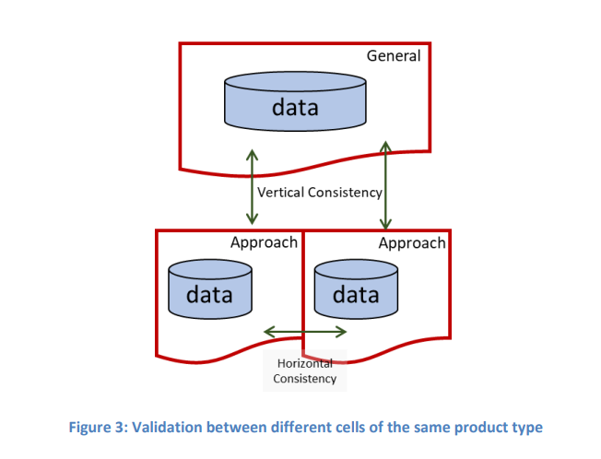
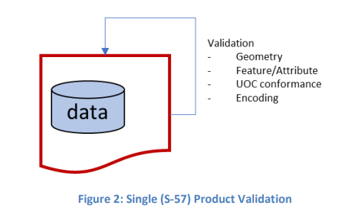
What is validation?
Intra – cell validation
Inter – cell validation

Slide 8
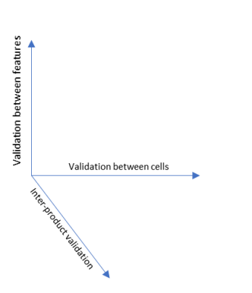
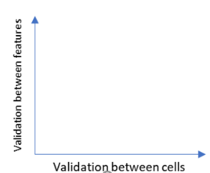
What is validation?
Intra-cell – Validation tests to ensure cell validates against itself
Inter-cell – Tests to ensure the cell validates against those it spatially intersects, touches or joins with
Now
S-100 Future
Intra
Intra
Inter
Inter
New dimension of validation

Slide 9
What is validation
At a simple level there are 3 types of data validation tests (content)
Inside cell
Between adjoining cells
Between product specifications for different types
Do we agree?
Responsibilities
Inside the Product Specification - intra and inter - lies with Product Specification owners
Outside - within this group?
With support from Product Specification owners
Is some of this temporary with the formation of an S-98 sub group?

Slide 10
S-100 Validation
S-100 Framework
FC Schema
Geometry
Encoding (8211, GML, HDF5)
Interoperability
S-98
b
c
Product Specification
FC₁
DCEG₁
FC₂
DCEG₂
Interoperability Catalogue
d
e
g
j
Dataset₁
f
Dataset₂
Dataset₃
Dataset(s)
a
i
h
S-128
CATALOG.XML₁
Notes:
Jonathan Pritchard diagram – different elements and types of validation
S-100 Framework at the top
2 Product Specifications (could be more) and their Feature Catalogues and DCEGs
Then Datasets made from these FC/ DCEG combinations
Notice there are dashed lines and arrows – these are the different types of validation which we will discuss next

Slide 11
Validation | Against | Who? | Notes / Examples
a | Dataset against itself | Data Producer | Incorrect ordering of features
b | S-100 Geometry Schema | Data Producer | Things which contravene the geometry model, e.g clockwise/anticlockwise rings, unused curves
c | S-100 Encoding (Part 10a, b or c) | Data Producer | Formatting problem with encodings, corrupt ISO8211, non-conformant GML, incorrect HDF5 group names, incorrectly formatted attributes (e.g. dates, Booleans or unknowns), bad filenames
d | Product Specification Feature Catalogue | Data Producer | Names of attributes or features which aren’t in the feature catalogue. Missing mandatory attribution
e | Product Specification DCEG |  | Bad combination of attributes
f | Against other datasets of the same type | Aggregator | Horizontal/vertical consistency
g | Datasets of a different type | Aggregator | e.g. S-102 depths shoaler than S-101 depths
h | Part 17 Catalogue (and Part 15) | Aggregator | Bad digital signatures, coverage of dataset doesn’t match coverage in catalogue, incorrect encoding or mismatch of producer code
i | Corresponding S-128 | Distributor? | Mismatch of coverage or dataset name.
j | Against interoperability catalogue | Producer | Incomplete substituted layer (L2), mismatch of positions (L1)
Responsibilities:
Who writes & maintains the different types of validation

Slide 12
S-100 Conformance Tests
Test dataset against FC
Standard for all Product Specifications – so all S-100 level?
Should that fall within PS validation or at S-100 validation level?

Slide 13
Validation between product specifications
Is this group responsible for tests between PS?
If yes, focus on interoperability?
Interleaves
Replaces features – bigger implications
How maintain onwards?
Is this a temporary home until S-98 sub group set up?

Slide 14
Progress so far
S-101 Project Team has reviewed S-58 and identified which validation tests are:
Relevant to S-101 and carried forward
Which tests are more generic S-100 tests
Initially identified some new tests for S-101

Slide 15
Progress so far…2
IIC Technologies have produced a Technical Report on Validation of S-100 datasets (Agenda item 8.1)
Covers background to validation
Beginning of description of ‘methodology’ of Validation
Primarily looking at S-101, S-102, S-104 & S-111
Proposed categorisation of S-100 Validation Tests
Initial list of 45 tests (Primarily focused of S-101, S-102, S-104 & S-111)
Testing validation of:
S-102 against S-101 using UKHO test data (Isle of Wight)
Working with US datasets to find examples of reconciling S-111 data with tidal data in S-101
https://iho.int/uploads/user/Services%20and%20Standards/S-100WG/S-100WG7/S100WG7-8.1_2022_EN_Validation%20Tests%20v7.3.0_Draft.pdf

Slide 16
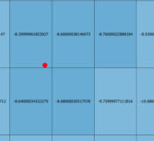
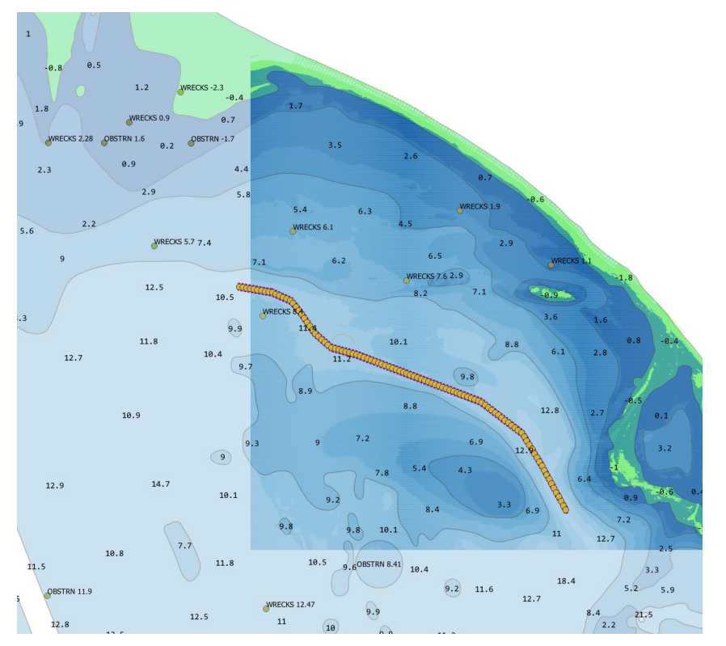
Progress so far…3
Summary of UKHO findings - wreck
S-101 Wreck feature (with a coincident Obstruction) with a valueOfSounding of 8.4m
S-102 value corresponding to the point feature (which is within the bounding rectangle of the S-102 point) is 8.39999961853027
Notes:
A route has been plotted through the region and the S-102 data overlaid on ENC polygons and features. As part of this testing, a number of tests were run, including sanity tests of values, formats, HDF5 formatting and metadata examinations of coverage and grids.
In order to experiment with cross-product validation the depths in the ENC (as defined by the S-101 depth areas and valueOfSounding attributes were cross referenced against the 500k depth value points in the S-102 dataset. This involved using the rectangular extents of each S-102 point (as described in the previous section using linear interpolation) against DepthArea polygons and features with value of sounding value

Slide 17
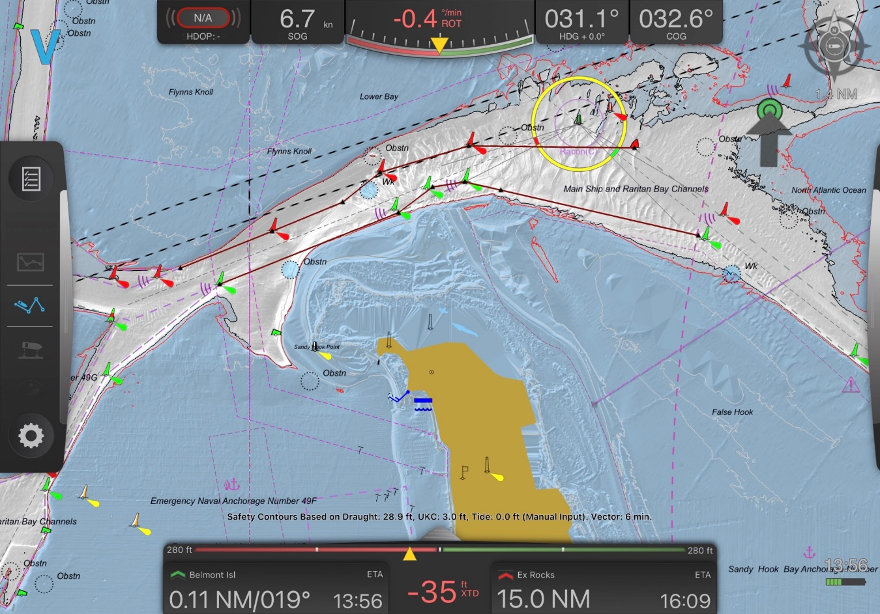
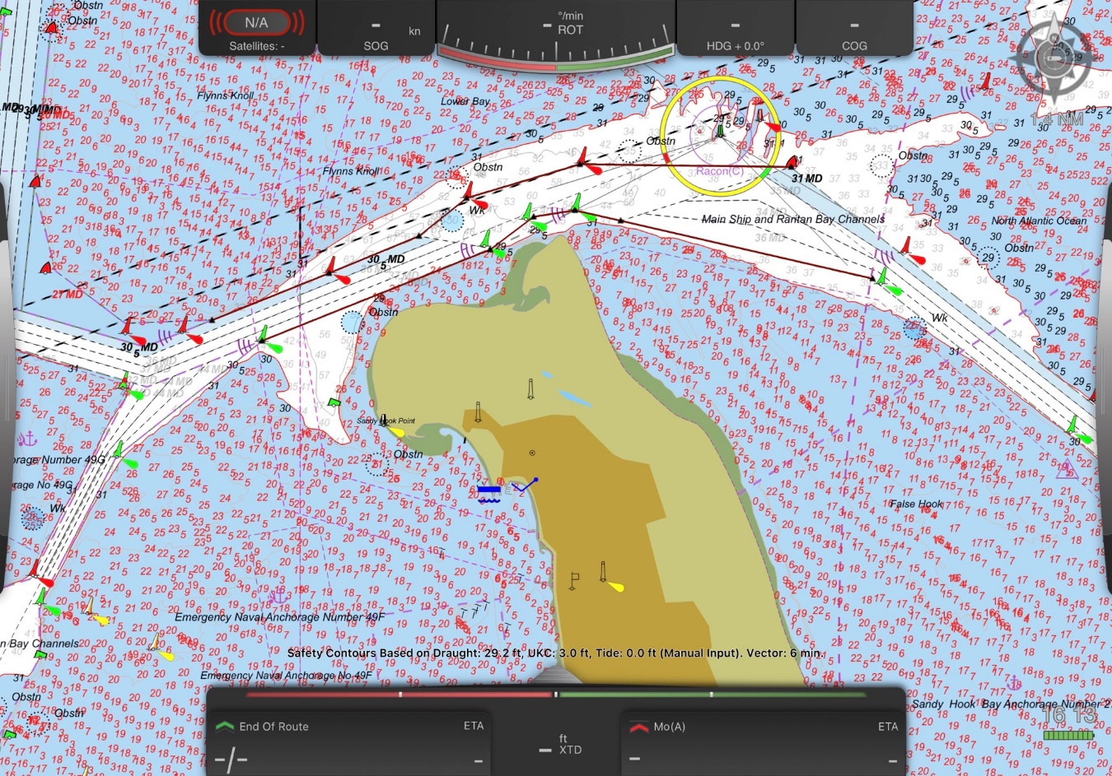
Progress so far…4
NOAA Sandy Hook – Interoperablity issues between products
S-102 with a user selected safety contour selected, however, the S-102 data was interpolated over land, so Sandy Hook is no longer visible on screen
S-102 Turned off

Slide 18
Progress so far…5
Have other Test Beds or organisations starting working on S-100 Validation tests that they are willing to share?
Production Software manufacturers
Validation Software manufacturers
RENCs
OEMs
Test Beds
Data producers
Others…

Slide 19
What is the deliverable?
List of S-100 Validation Tests - is this a Part of S-100 or separate standard (S-158?)
What is the format of these tests – propose use IICs suggestion to start with
Explanatory section including description of what ‘Validation’ is
Recommendation of how we organise validation between different products – Is this S-98 now?
How do, how record, how update/maintain
Update S-97?
Guidance document for data producers?
But not hold up factor
Scope of work - is this limited in the first instance to Route Monitoring PSs?
Link to DCEG?

Slide 20
assumptions
S-101 must always be ‘safest’
Do we need a definition
Must be possible to use S-101 ENC without additional S-xxx products
Do we need a generic list of assumptions and/or ones specific between product specifications?
Combination of products must be least as safe as individual
“After S-57 is no longer a live standard, the S-57 tests can be deleted from the test cases and documentation without any impact. Therefore, S-100 and S-57 datasets should be standalone (except where specific DF tests are planned/executed)” – S-164
So want to keep S-58 & S-158 separate

Slide 21
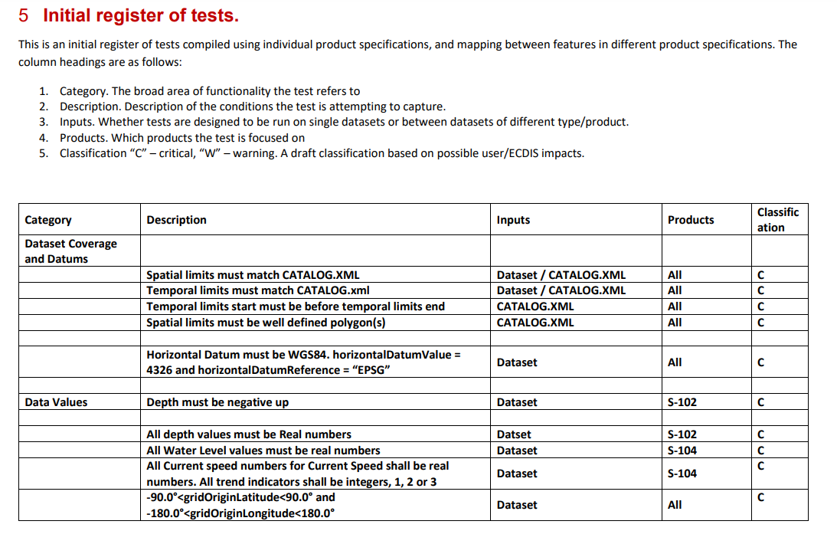
Proposed structure for tests
Propose adding Standard/document to refer to
Categories:
Dataset Coverage and Datums
Data Values
Coverage
Grid Structure
Resolution
Dataset Metadata
Cross Validation

Slide 22
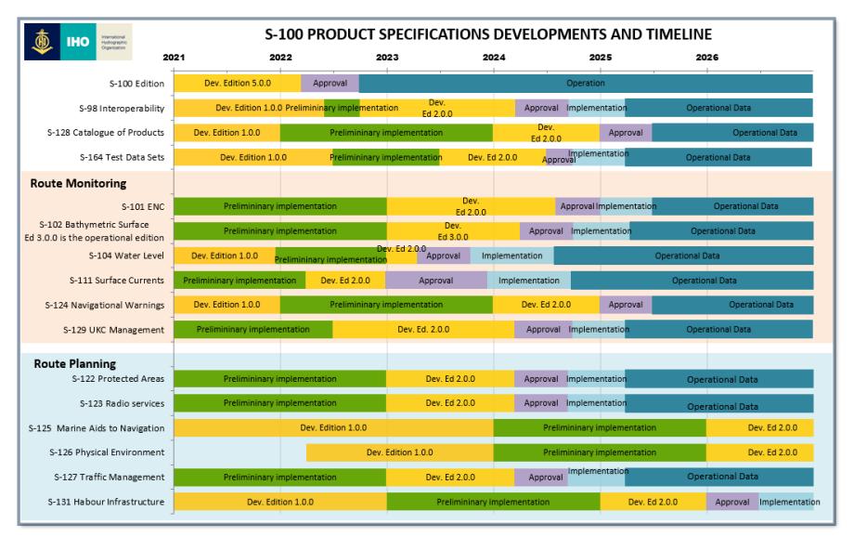
When is it required/ DEpendencies?
When required?
Are there phases
What is phase 1? Route Monitoring
What are S-100 Validation tests a dependency to?
Product Specifications being ready for Ed. 2.0.0
Generic tests & FC
Revisit once Interoperability catalogue produced

Slide 23
DEpendencies
Test data is required to test validation
Potentially work with Test Beds and RENCs to start with
Resources to test
IHO Singapore Lab?
Link between S-164 and S-100 Validation Tests
S-164 needs to be validated?
Do we need S-164 datasets for S-100 Validation Tests?

Slide 24
What work is required?
Initial work
Establish GitHub page
Identifying which scenarios require validation & who responsible
Identifying who to contact
Agree to use IICs test structure?
Insert S-101 PT S-100 tests into new structure
Start producing simple document explaining:
‘What validation is’
How it is structured
Identifying responsibilities for different parts of validation
Review Governance Docs gaps
Session at TSM
Request S-158
Further work
Identify other S-100 Validation tests – do we need a full review?
Potentially set up a test scenario for users/ Test beds to test and report back issues found

Slide 25
Sum up
Establish list of volunteers – contact WG/PS owners not present
Next meeting
VTC correspondence group
1st meeting beginning of February? (S-101to S-57 conversion meeting end Jan)
How regularly meet? Monthly?
Test Strategy Meeting in early March
HSSC meeting June
Maintenance / Updating regime

